Slide 1
Scrum Roles
02

Slide 2
There are three fundamental roles in the Scrum method of agile software development:
Product Owner.
ScrumMaster.
The Development team.

Slide 3
There are also supporting roles but these are not part of scrum itself but still Important to its success .e.g.
Subject matter experts
Business owner
Stake holders

Slide 4
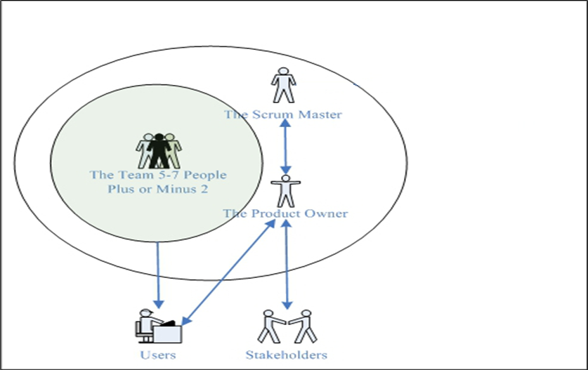

Slide 5
1. Scrum Master
SCRUM Master is not a team/ project/ line manager.
SCRUM Master has not the authority over the team members.
SCRUM Master is not necessarily a team member
SCRUM Master is not necessarily the most experienced team member

Slide 6
SCRUM Master Facilitates the team
SCRUM Master Ensures SCRUM principles are implemented
SCRUM Master Resolves impediments
SCRUM Master Protects the team
SCRUM Masters Coaches the team

Slide 7
2. Product Owner
As the name suggests, a Product Owner should own the product on behalf of the company.
The Product Owner is responsible for prioritizing the backlog during Scrum development, to ensure it’s up to par as more is learned about the system being built, its users, the team and so on.

Slide 8
Product is responsible for writing for user stories
Product owner is one person responsible for collecting all information from the stake holders and presenting it one prioritised list for the team to actually accomplish
They are the person to accept and reject the work done

Slide 9
The Product Owner must be knowledgeable i.e. they must have the knowledge about the product and specially the user requirements
They must be empowered i.e. have the authority to accept or reject the product
The Product Owner is the person to mange the stake holder and sponsor expectations
Product Owner is responsible for Prioritizing the item in the product backlog

Slide 10
The Product Owner is the person most responsible for managing the Product Backlog. Product Backlog management includes:
Clearly expressing Product Backlog items;
Ordering the items in the Product Backlog to best achieve goals and missions;
Ensuring the value of the work the Development Team performs;

Slide 11
Ensuring that the Product Backlog is visible, transparent, and clear to all, and shows what the Scrum Team will work on next; and,
Ensuring the Development Team understands items in the Product Backlog to the level needed

Slide 12
The Product Owner may do the above work, or have the Development Team do it. However, the Product Owner remains accountable.
The Product Owner is one person, not a committee. The Product Owner may represent the desires of a committee in the Product Backlog, but those wanting to change a backlog item’s priority must convince the Product Owner.

Slide 13
For the Product Owner to succeed, the entire organization must respect his or her decisions. The
Product Owner’s decisions are visible in the content and ordering of the Product Backlog.
No one is allowed to tell the Development Team to work from a different set of requirements

Slide 14
3.The Development Team
The Development Team consists of professionals who do the work of delivering a potentially releasable Increment of “Done” product at the end of each Sprint.
Only members of the Development Team create the Increment.

Slide 15
Development Teams are structured and empowered by the organization to organize and manage their own work. The resulting synergy optimizes the Development Team’s overall efficiency and effectiveness.

Slide 16
Development Teams have the following characteristics:
They are self-organizing. No one (not even the Scrum Master) tells the Development Team how to turn Product Backlog into Increments of potentially releasable functionality;
Development Teams are cross-functional, with all of the skills as a team necessary to create a product Increment;

Slide 17
Scrum recognizes no titles for Development Team members other than Developer, regardless of the work being performed by the person; there are no exceptions to this rule; ( but as QA is a learning environment the team needs a team leader)
Individual Development Team members may have specialized skills and areas of focus, but accountability belongs to the Development Team as a whole; and,
Development Teams do not contain sub-teams dedicated to particular domains like testing or business analysis.

Slide 18
Development Team Size
Optimal Development Team size is small enough to remain nimble and large enough to complete significant work.
Fewer than three Development Team members decreases interaction and results in smaller productivity gains.
Smaller Development Teams may encounter skill constraints during the Sprint, causing the Development Team to be unable to deliver a potentially releasable Increment.

Slide 19
Having more than nine members requires too much coordination.
Large Development Teams generate too much complexity for an empirical process to manage.
The optimal size for a Team is seven people, plus or minus two.
The Product Owner and Scrum Master roles are not included in this count unless they are also executing the work of the Sprint Backlog.

Slide 20
Scrum Master Service to the Product Owner
The Scrum Master serves the Product Owner in several ways, including:
Finding techniques for effective Product Backlog management;
Clearly communicating vision, goals, and Product Backlog items to the Development Team;
Teaching the Scrum Team to create clear and concise Product Backlog items;
Understanding long-term product planning in an empirical environment;
Understanding and practicing agility; and,
Facilitating Scrum events as requested or needed.

Slide 21
Scrum Master Service to the Development Team
The Scrum Master serves the Development Team in several ways, including:
Coaching the Development Team in self-organization and cross-functionality;
Teaching and leading the Development Team to create high-value products;
Removing impediments to the Development Team’s progress;
Facilitating Scrum events as requested or needed; and,
Coaching the Development Team in organizational environments in which Scrum is not yet fully adopted and understood.

Slide 22
Thank you
QA hopes you enjoyed your course,
as much as we enjoyed teaching you.

